Slide 1







NovaMed Solutions:
Pharmaceutical Distributor
TOBILOBA M. ADENIYI

Slide 2

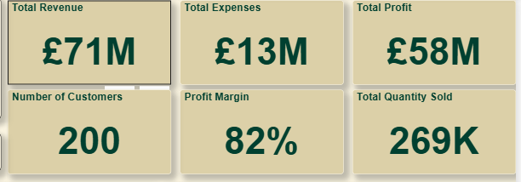

💰 £71M Revenue – lean operations
📉 £13M Expenses – efficient cost control
📈 £58M Profit – strong bottom-line
🥧 82% Margin – pricing power
👥 200 Customers – high-value engagements
📦 269K Units Sold – strong demand
Key Sales Indicators

Slide 3

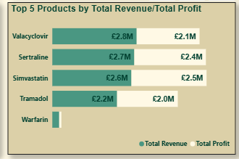

🥇 Simvastatin – highest profit efficiency (96% margin)
💊 Sertraline – strong profit with lean costs
💰 Valacyclovir – leads in total revenue among top 5
📉 All products – maintain high margins, showing cost control
⚖️ Product mix – reflects balanced revenue and profitability

Slide 4
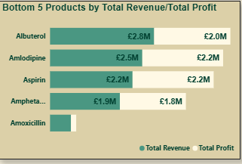
💨 Albuterol – £2.8M Revenue | £2.0M Profit Moderate margin, potential for cost optimization
💊 Amlodipine – £2.5M Revenue | £2.2M Profit Stable performer with lean cost structure
🧪 Aspirin – £2.2M Revenue | £2.2M Profit Break-even profile—zero cost or margin anomaly
⚡ Amphetamine – £1.9M Revenue | £1.8M Prof
it Consistent margin, low volume
🧫 Amoxicillin – Lowest revenue & profit Underperforming—review pricing or demand strategy

Slide 5
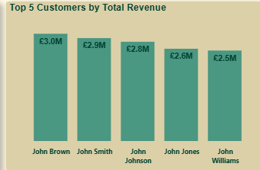
🧑‍💼 John Brown: - Top contributor; focus on retention
🧑‍💼 John Smith: - High performer; maintain engagement
🧑‍💼 John Johnson: - Strong revenue; upsell potential
🧑‍💼 John Jones: - Reliable; ensure ongoing support
🧑‍💼 John Williams: - Valuable; pursue growth opportunities

Slide 6
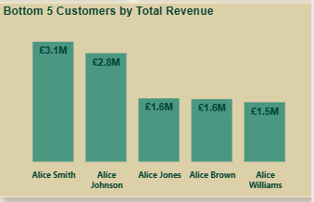
👤 Alice Smith –Lowest of top-tier contributors, potential for upsell.
👤 Alice Johnson – Stable mid-range performer, underleveraged.
👤 Alice Jones – Low revenue; needs engagement review.
👤 Alice Brown– Like Jones, growth opportunities exist.
👤 Alice Williams –Lowest revenue; focus on retention or reactivation

Slide 7

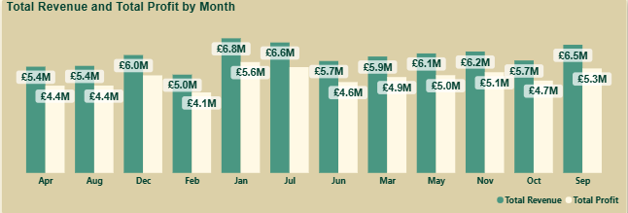

📈 January – £6.8M Revenue | £5.6M Profit Peak revenue month—strong start to Q1
💰 December & May – £6.6M Revenue | £5.6M Profit Consistent high performance—seasonal strength
📊 October – £6.2M Revenue | £5.7M Profit Highest profit margin—efficient operations
📉 August & February – Lower profit margins Review cost structure or demand dip
🔄 Overall Trend – Stable revenue, strong profitability Margins remain healthy across most months

Slide 8
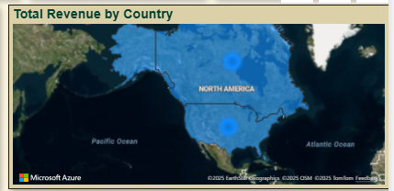
🇺🇸 United States: highest revenue concentration and strong demand
📍 Hotspots: two key revenue hubs tied to distribution and clients
🧭 North America focus: limited global reach, opportunity for expansion

Slide 9

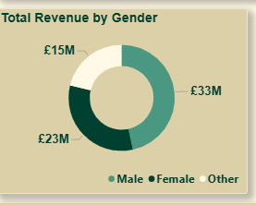

👨 Male – Largest revenue segment—key demographic
👩 Female – Strong contributor—growth potential
🧑‍🦱 Other – Emerging segment—opportunity for inclusion strategy
Ginyard ensures hospitals get what they need, on time and fully compliant.

Slide 10


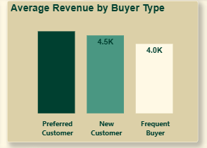


🌟 Preferred Customer – £4.5K High-value segment—consistent top-tier spend
🆕 New Customer – £4.5K Strong initial engagement—promising acquisition strategy
🔁 Frequent Buyer – £4.0K Loyal but lower spend—opportunity to increase market size

Slide 11

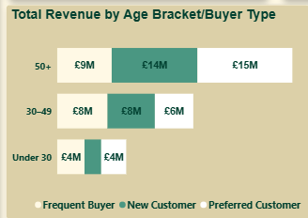


👵 50+ Age Group—Most profitable segment—strong across all buyer types
👨‍💼 30–49 Age Bracket - Balanced performance; slightly lower preferred spend.
🧑 Under 30 Age Bracket - Lowest contribution—no premium engagement

Slide 12
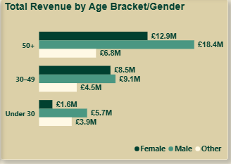
👵 50+ Age Group— Highest overall revenue—male segment leads
👨‍💼 30–49 Age Bracket - Balanced performance—slight male lead.
🧑 Under 30 Age Bracket - Lowest contribution—female segment strongest

Slide 13


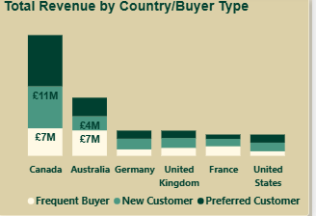


● Canada - Top-performing market with a diverse buyer mix
● Australia
- Second-highest revenue with stable segmentation
● Germany - Evenly distributed, low total revenue—growth potential
● United Kingdom - Balanced but modest; review engagement strategy
● France - Opportunity to increase buyer conversion
● United States - Lowest revenue, underperforming; reassess market approach

Slide 14
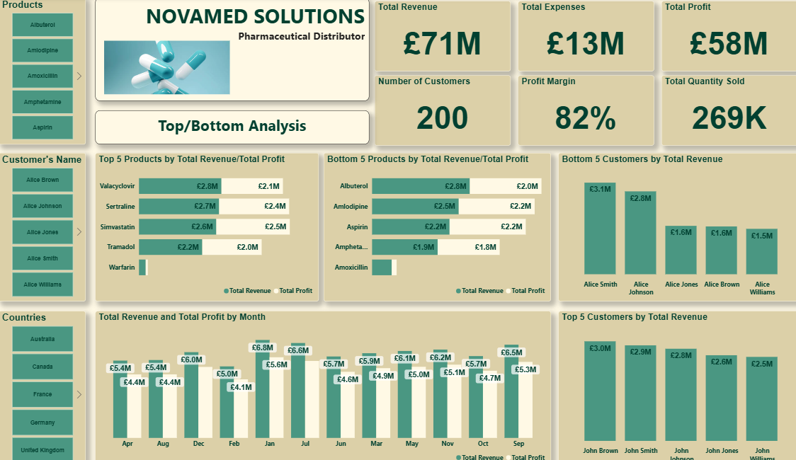
🧪 Top products drive profit.
🔻 Bottom products need review.
👤 Few customers dominate sales.
🌍 UK leads, others lag.
📅 Revenue is steady; monitor for changes.

Slide 15
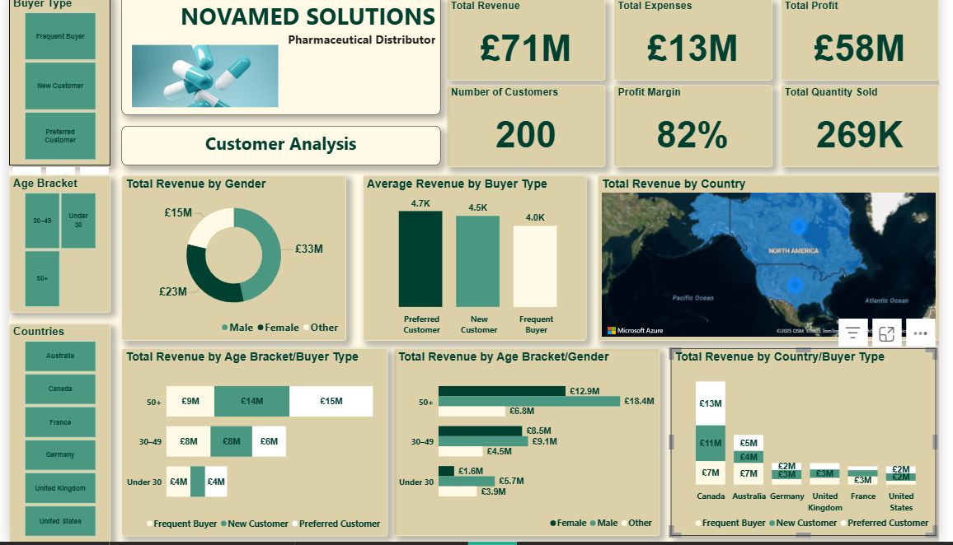
💰 Strong revenue, lean costs
📈 High profit, healthy margin
👥 Solid customer base
👨 Dominant male segment
🇬🇧 UK leads market
🔁 Frequent buyers spend more
👵 Older age group drives value
🌍 UK + older males = top segment

Slide 16
RECOMMENDATIONS
🔁 Prioritize Frequent Buyers: Focus loyalty efforts on this high-revenue group.
👴 Target Older Males: Tailor messaging and offers to profit-driven customers.
🇬🇧 Strengthen the UK Market: Scale successful strategies in your strongest region.
🧪 Phase Out Weak Products: Discontinue underperforming items to free up resources.
🆕 Enhance New Customer Value: Introduce upselling opportunities to increase spending.
📅 Adjust for Seasonal Dips: Plan promotions to address identified periods of low sales.

Slide 17
Thank you

